Slide 1

ASYNC PROGRAMMING

Slide 2
AGENDA
SYNCHRONOUS
ASYNCHRONOUS
MULTITHREAD
EGGS WITH TOASTS
ASYNC IN JS
FIRST TIME WITH JS
PROMISES
ASYNC/AWAIT
PROMISES, AGAIN
BEST PRACTICES
QUESTIONS
CALLBACKS

Slide 3
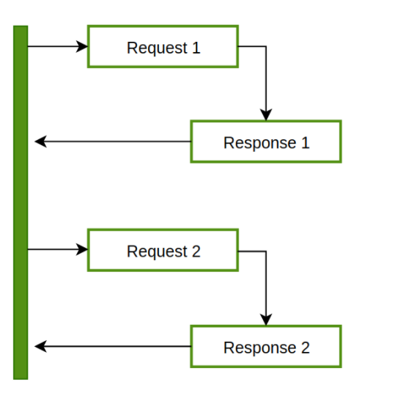
Synchronous
Operations take place sequentially in the same Thread
Long running operations can lead to “Blocking”
Read a file, process an image, make a request…
Notes:
https://mdn.github.io/learning-area/javascript/asynchronous/introducing/simple-sync.html

Slide 4
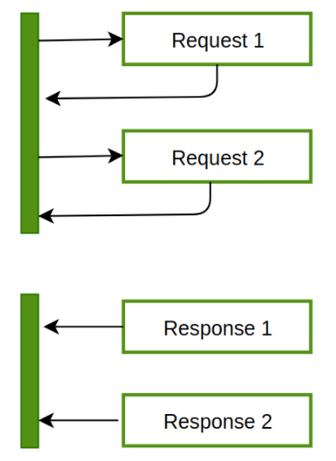
ASYNCHRONOUS
Run in one Thread
Fire the heavy operation and continue with other things
Callback the main process when heavy things are finished

Slide 5
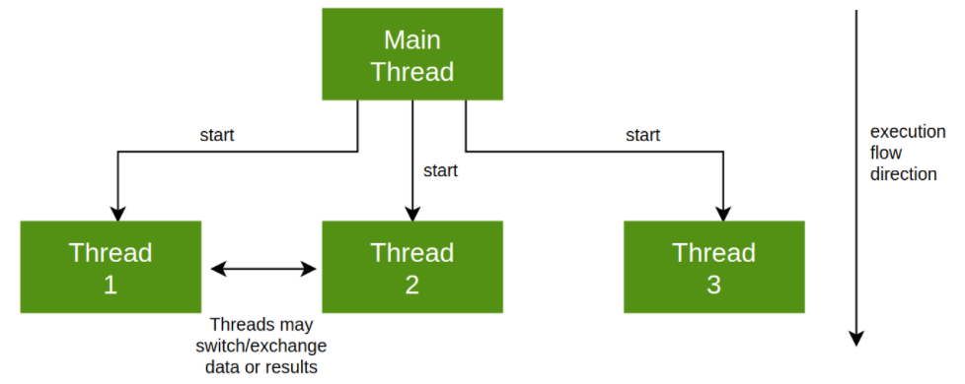
Multithread
Run in multiple Threads
“Parallel execution”
Concurrent exection sharing resources

Slide 6
EGGS WITH TOASTS
SYNCHRONOUS
ASYNC
MULTITHREAD
Prepare eggs
Wait for the eggs
Prepare toasts
Wait for the toasts
Serve
Prepare eggs and set timer
Prepare toasts and set timer
Clean your kitchen (for once)
Serve when ready
Hire 2 cooks
One prepares toasts the other eggs
Synchronize them
Pay both cooks
Serve

Slide 7
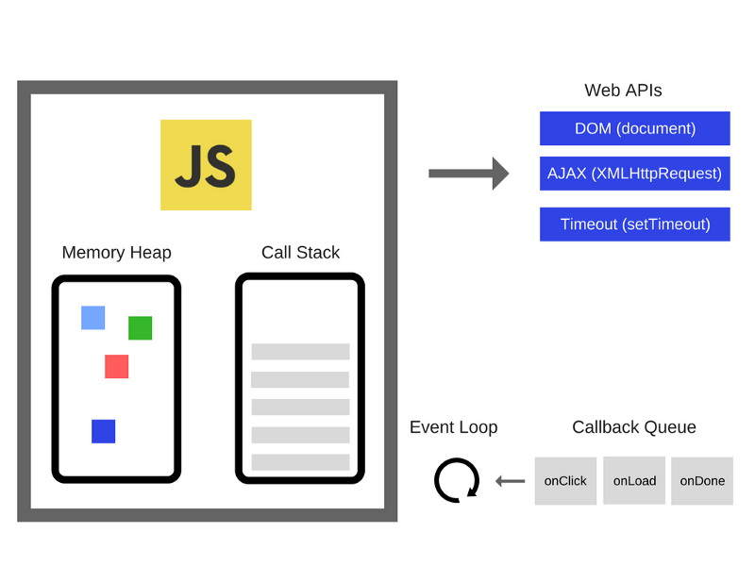
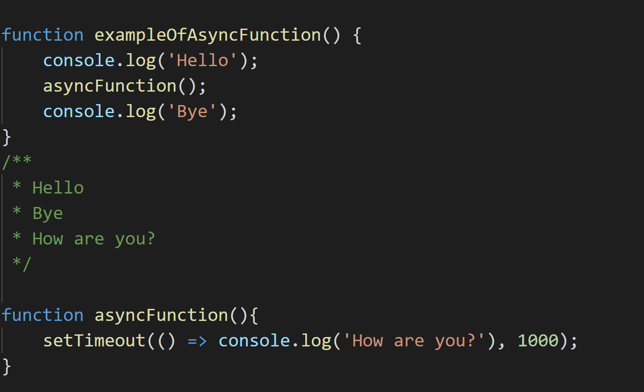
Async in javascript
‘’JavaScript is async’’
Single Threaded
Use of callbacks

Slide 8


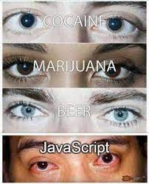
First time with js
‘’Bruh I should have x in y variable’’
‘’WTF is a Promise’’
Response.json is not a function

Slide 9

Callbacks
Function to be called when the async operation finishes
Pass the callback as argument to the function
Then call the callback inside the function

Slide 10

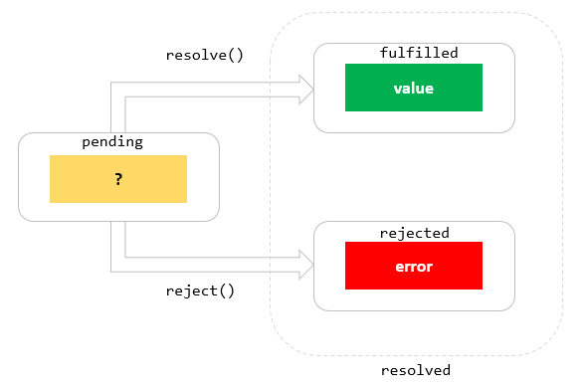
promises
New Object introduced with ES6 version in 2015
Used to handle async events that will be treated in the future
new Promise((resolved, rejected)
.then(onfulfilled).catch(rejected)

Slide 11
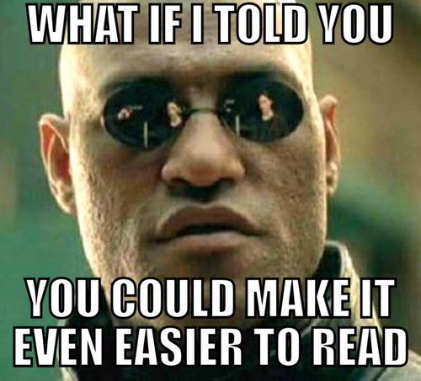
ASYNC/AWAIT
Introduced since ES2017
New two keywords: async and await
Syntactic sugar
Async wraps the function in a new Promise
Await forces to stop the execution until the Promise is resolved
Avoid ‘’callback hell’’
Easier to handle errors (try, catch)
> Promises

Slide 12

Promises, again
Promise.all(promises)
Promise.allSettled(promises)
Promise.any(promises)
Promise.race(promises)
Returns a promise when all promises are fulfilled or rejected
Returns a promise when all promises are resolved
Returns the first promise fulfilled
Returns the first promise resolved

Slide 13
Best practices
Await as late as possible
1
Remember that async/await are promises
2
Think when do you want to await
3
Keep using promises
4

Slide 14
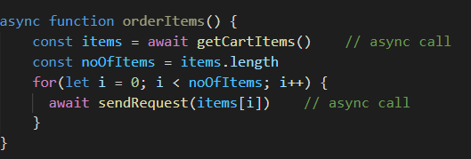
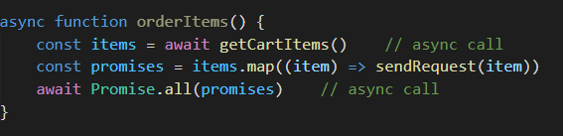
Example

Slide 15

questions

